Slide 1
Observations of the 18cm OH lines of 23 comets
Research by Amy Lovell, Brynn Presler-Marshall, and Aysha Rahman
Presented by Aysha Rahman
Notes:
Hello everyone. My name is Aysha Rahman, and I’ll be talking to you about research I did in 2017 presenting observations of the 18 cm OH lines of 23 comets. I conducted this research with Brynn Presler-Marshall and Dr. Amy Lovell of Agnes Scott College.
Abstract: Comets are primitive bodies that provide a unique window into the evolution of the early solar system. Spectra of 18cm OH emissions from 23 comets are used to model coma kinematics, giving insights into cometary evolution. Observations were made using the Arecibo 305m radio telescope and the 100m National Radio Astronomy Observatory (NRAO) Green Bank Telescope (GBT) of the comets as they neared perihelion. Presented here are preliminary results regarding gas production rates and velocities of OH molecules based on these observations. The resultant molecular velocities range from 0.47 km/s to 3.273 km/s, and the gas production rates cover three orders of magnitude from 0.36 to 123.9 x10^28 molecules/s.

Slide 2
Overview
Background
Motivation
Orbits
Chemical Processes
Methods
Aim
Observations
Monte Carlo
Spectral Mapping
Results
Maps
Conclusions and Future Work
Acknowledgments
Notes:
Before we begin, here is an overview of the points I will discuss. We will begin with the background, which includes the motivation behind studying comets, a description of comet orbits and anatomy, and a review of the chemical processes observed.
Next, we will discuss our methods. Here, we will deliver our aim, introduce the data from our observations, and talk about the methods we used to analyze it.
After that, we will discuss our results, showing maps, drawing conclusions, and detailing future work.

Slide 3
Background

Slide 4
Motivation
Primitive solar system bodies
Early solar system/solar system formation
Earth’s evolution and water origin
Notes:
Why study comets in the first place? Comets are primitive bodies that have remained largely unchanged since the formation of the solar system, and thus are critical to understanding the early solar system and the process of solar system/planetary formation. By studying comets and cometary evolution, we can understand the composition and conditions that formed the early solar system, planetary evolution, and the origins of water on Earth.
NOTES: a few hundred meters to tens of kilometers across and are composed of loose collections of ice, dust, and small rocky particles. The coma may be up to 15 times Earth's diameter, while the tail may stretch beyond one astronomical unit.

Slide 5
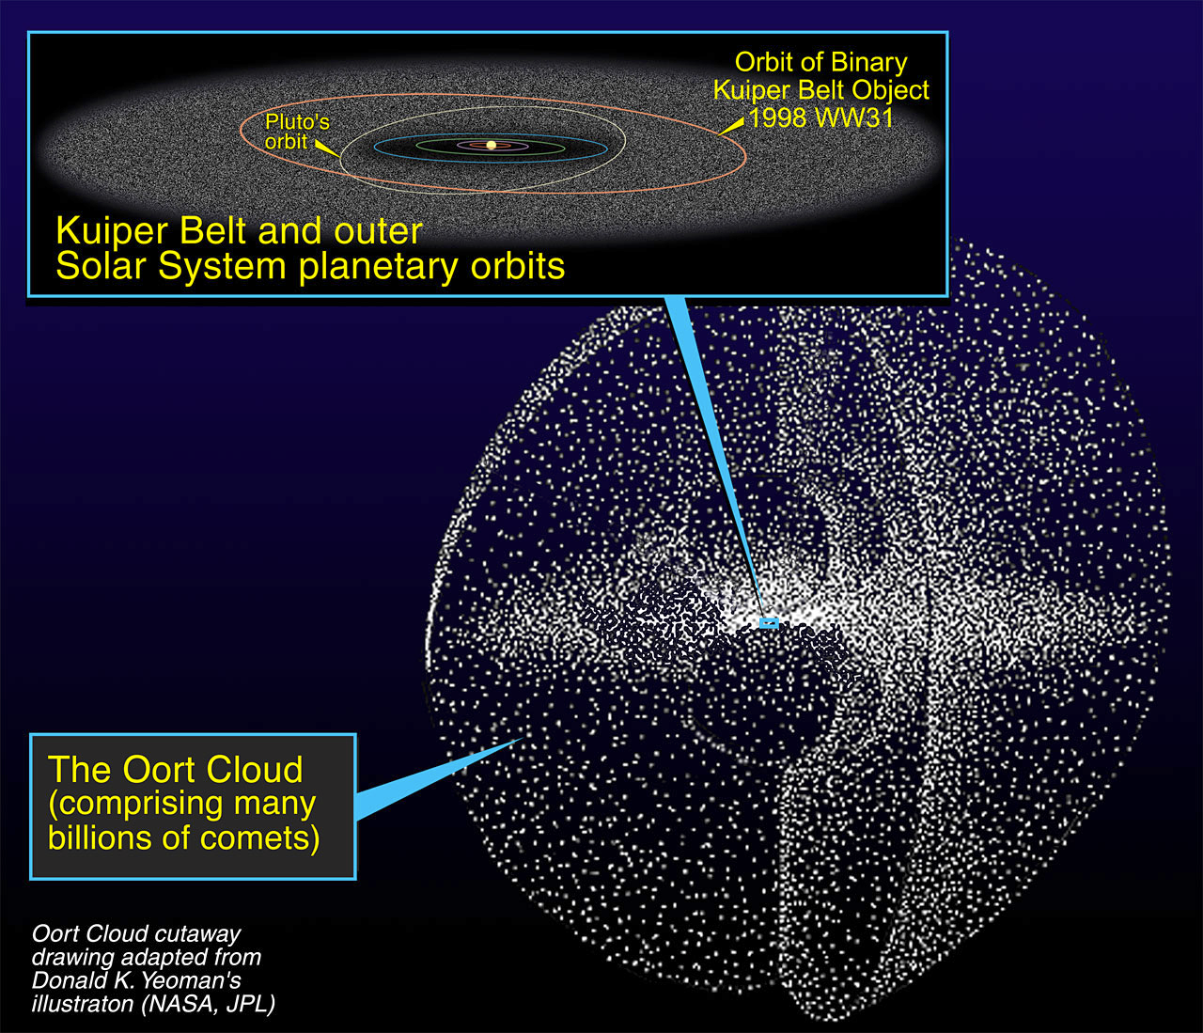
Orbits
Figure 1: Oort Cloud and Kuiper Belt diagram Credit: NASA/ESA and A. Feild (Space Telescope Science Institute)
Notes:
Comets have highly elliptical orbits and spend most of their time far away from the Sun. For this reason, they have remained largely unchanged throughout time, and are some of the best objects to study to get a sense of the early solar system. Comets come from two regions: the Kuiper belt, just past Neptune at 30 AU, and the Oort cloud, a spherical cloud of icy objects sitting at a range of 2,000 to 200,000 AU. Comets do get altered each time they near perihelion, which is the point at which an orbiting body in the solar system is closest to the Sun, and they are altered in a process called outgassing where the volatile compounds in their ices sublimate to form a non-gravitationally bound atmosphere, so comets with shorter periods/that come from the Kuiper belt are more altered than comets from the Oort cloud.
Comets in the Oort cloud can also evolve by irradiation from cosmic rays that can deplete volatile materials and stabilize their crusts, and they can gain new material through interaction with dust grains in the interstellar medium. Because of the stability of their crusts, beyond a few centimeters from the surface, they are well-preserved and thus contain pure, unprocessed material from the formation of the solar system. These comets can really just be studied once, given their great distances which result in extremely long periods too long for multiple studies by humans/that outlast generations upon generations of human lifetimes.
https://esahubble.org/images/opo0204i/

Slide 6
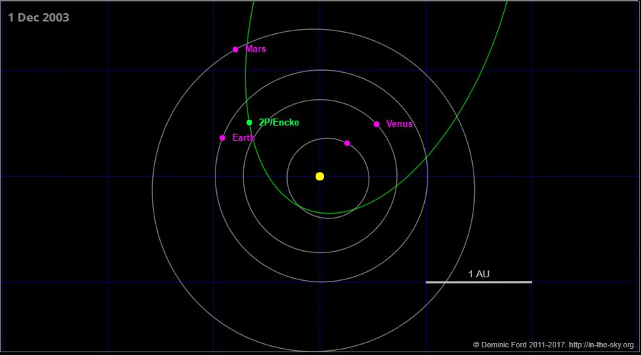
Sample Orbit
Figure 2: Orbit of comet 2P/Encke Credit: Dominic Ford, in-the-sky.org
Notes:
This diagram shows the orbit of comet 2P/Encke, which has the shortest orbital period of any known comet at 3.3 years. Here we see the position of Encke relative to the Sun and the inner planets on December 1, 2003.
The P in its name indicates that it is a periodic comet, which has a period of less than 200 years, and it was the second periodic comet discovered, after Halley’s Comet, which is designated 1P/Halley.
NOTES:
Comets tend to be named after their discoverers, but Encke was named after the astronomer Johann Franz Encke who calculated its orbit.

Slide 7
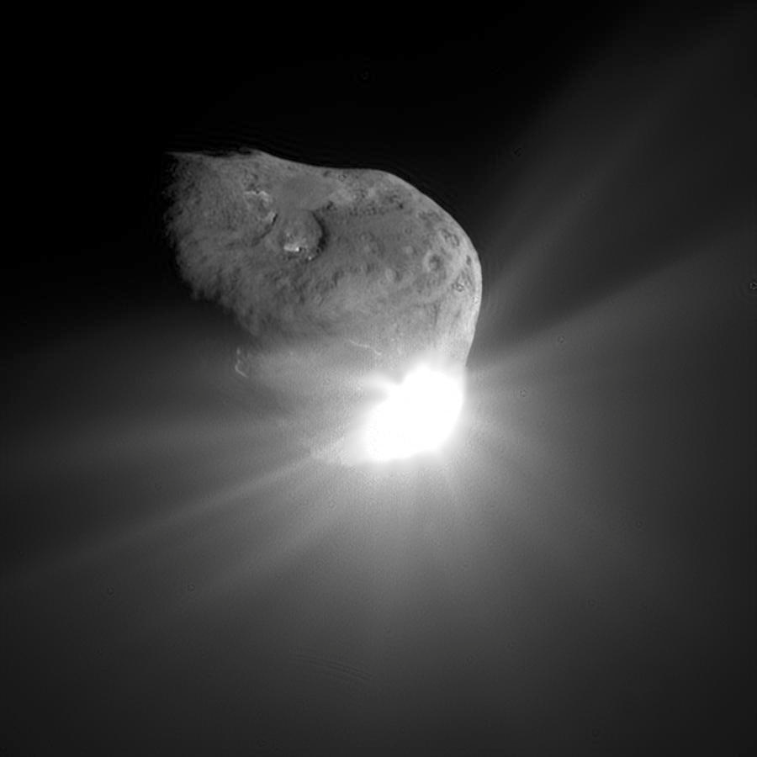
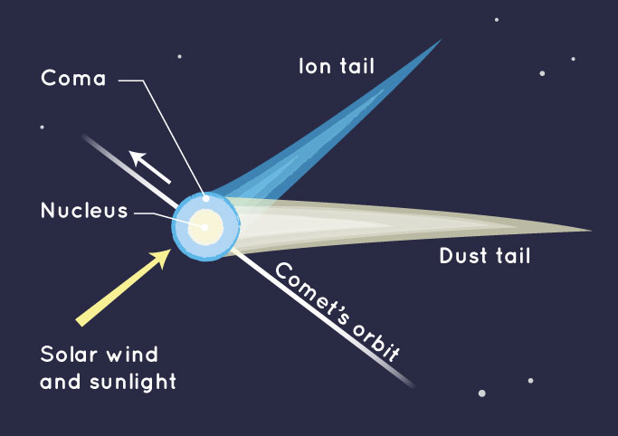
Comet Anatomy
Comet 9P/Tempel 1 Credit: NASA/JPL-Caltech/UMD
Figure 3: Diagram of comet anatomy Credit: NASA/JPL-Caltech
Notes:
Comets have famously been described as “dirty snowballs” and are primarily made of water ice as well as small amounts of ices of other volatile compounds, and about 20% dust. Comets are also very dark, and the combination of their small size with their extremely low albedos means there is only a limited amount of time when they are observable.
As a comet approaches perihelion, it interacts with solar wind and radiation, which sublimates the ices in the comet and creates what is called a coma of mostly gas and some dust around the nucleus of the comet, as well as both ion and dust tails. The coma of a comet can stretch for tens of thousands of kilometers (Astro2020 Science White Paper) , and these comas can be observed to determine chemical composition and behavior of comets. This loss of volatile material during perihelion means that comets with shorter periods undergo further evolution than their distant counterparts.
https://spaceplace.nasa.gov/comets/en/

Slide 8
Photodissociation
Figure 4: Photodissociation of water molecules into hydrogen and hydroxide ions
Solar UV
H₂
Photodissociation
OH⁻
H₂O
Notes:
Many of the compounds in the sublimating ice have transitions observable in radio and millimeter-wave bands (Astro2020 Science White Paper). Solar UV radiation photo-disassociates parent water molecules in the coma into hydrogen and hydroxide ions. These daughter OH molecules have emission lines at 18 cm as lambda doublets.
We look at OH lines because comets contain mainly water ice, but ground-based observations of water are difficult to observe due to the water present in Earth’s atmosphere. Thus, OH spectra are a valuable tool to study the outgassing process of comets.

Slide 9
Methods

Slide 10
Aim
To map and model gas production rates and outflow velocities of OH⁻ molecules in comets nearing perihelion
Notes:
The goal of this project is to map and model gas production rates and outflow velocities of OH molecules in comets nearing perihelion.

Slide 11
Observations
Data spanning 16 years (2001-2017)
Over 30 comets; we look at 23
Arecibo Observatory and Green Bank Telescope, ground-based radio observations, 18 cm Λ-doublet
Notes:
Our data comes from observations across 16 years, from the years of 2001-2017, and over 30 comets, 23 of which are represented in this project. The observations were made at the Green Bank Observatory and the Arecibo Observatory (the latter of which is no longer with us, rest in peace). These telescopes are used for radio astronomy, and we see our OH lines in the 18 cm lambda doublet transitions.
NOTES:
OH is visible in the 18 cm lambda doublet. The signal is split into two subpeaks of equal height (and area) – this is referred to as a doublet.

Slide 12
Monte Carlo Simulation
Produce synthetic coma, divide into sections, look at doppler shift to map
Generate 10^6 H₂O molecules, sublimated
Randomly assign parent production time, parent destruction time, daughter destruction time, and azimuthal (𝞅) and polar (𝝧) angles of motion for each molecule
Grid of different sublimation/initial velocity v₀ and quenching radii r_{q}
Notes:
Our simulation produces a synthetic coma, which we divide into different sections to determine how each section is doppler shifted in order to map the coma.
We use the Monte Carlo method to generate a million randomly moving water molecules at the time of sublimation; while the method produces some variation each time the code is run, having a million molecules minimizes the stochastic deviations.
Random values are assigned to parent production and destruction times, daughter destruction time, and angles of motion for each molecule.
The model is run on a grid of different initial velocities and quenching radii
The quenching radius describes the radius of dense inner coma
Depending on the motion of the comet and its heliocentric distance rH, the water molecules accelerate in random directions.
The parent water molecules are given a lifespan of 80,000 s (22.2 hours), and the velocity is assumed to be about 0.8 km/s. When the water molecules die due to photodissociation, the daughter OH molecules are given an additional acceleration due to splitting of the parent molecules. The same acceleration is used for both species due to their similarity in size.
Depending on heliocentric distance r_{H} water molecules accelerate in random directions
Parent H₂O lifespan = 80,000 s
Velocity v = 0.8 km/s
Quenching radius: dense inner coma with suppressed emission, to be fit by model
From Lovell magnum opus:
excitation of the levels depends on the heliocentric radial velocity of the gas,
If the coma density is sufficiently large, then frequent gas collisions will thermalize and “quench” the OH emission in the inner coma.
We assume a uniform velocity with which the OH parent molecules (presumably H2O) emerge from the nucleus. This velocity is added vectorially to the velocity of photo-dissociation as the OH is formed. The observed distribution of OH radicals in the coma then depends on the production of the parent molecules from the nucleus, as well as the velocities and lifetimes of both parent and daughter species. A further complication in the observed distribution is the effect of collisional quenching of the Λ-doublet. In a high-density coma, the OH emission is thermalized by collisions, and quenched within some cometocentric radius, rQ. This effect suppresses the strong inner-coma emission, making any offset spectra appear stronger in comparison to the center, and affecting the line shapes by lowering the contribution of the inner-coma velocities in the spectrum. The radius rQ is a free parameter, in km, to be fit by the model.
The ejection velocity of the daughter OH is fixed at 1.05 km s−1, with the parent outflow velocity vP left as a free parameter in the model. Photo-dissociation lifetimes are theoretical values for a heliocentric distance of 1 AU, adjusted for the time of observation by a multiplicative factor of rh^2.
.
From Tacconi-Garman (1990)
employ the powerful Monte Carlo technique in an effort to reproduce the high-sensitivity, high
spectral resolution 18 cm OH line profiles of comets
From Wiki:
rely on repeated random sampling to obtain numerical results. The underlying concept is to use randomness to solve problems that might be deterministic in principle. They are often used in physical and mathematical problems and are most useful when it is difficult or impossible to use other approaches. Monte Carlo methods are mainly used in three problem classes:[1] optimization, numerical integration, and generating draws from a probability distribution.
From Brynn’s undergrad thesis:
The observed spectra are modeled using a Monte Carlo simulation that generates a
synthetic coma and allows the molecules to move in random directions. The model first
generates a million water molecules as if they have just sublimated from the nucleus. While
the nature of a Monte Carlo simulations means there will be slight variations each time the
code is run, a million molecules is large enough to minimize the stochastic deviations
while also minimizing the time required to run. Over the lifetime of the water molecule,
as determined by the heliocentric distance of the comet at the time of observation, the
molecules are then allowed to linearly accelerate in a random direction. When the parent
water molecule dies, it produces the daughter molecule OH, which is given an increase in
velocity as a result of the water molecule splitting. The OH molecule is then once again
accelerated in the same direction as the parent molecule. Given the similar mass between
water and OH (18.02 amu and 17.01 amu, respectively), the same acceleration was used
for both species of molecules.

Slide 13
Calculations
Parent lifetime 𝚫t₁, sine and cosine projections
Final parent position:
x₁₂ = v₀ 𝚫t₁ sin(𝝧₁) cos(𝞅₁)
y₁₂ = v₀ 𝚫t₁ sin(𝝧₁) sin(𝞅₁)
z₁₂ = v₀ 𝚫t₁ cos(𝝧₁)
Velocity due to photodissociation v_{p} = 1.05 km/s
Final daughter x-velocity, sublimation + photodissociation
v₃ = v₀ sin(𝝧₁) cos(𝞅₁) + v_{p} sin(𝝧₂) cos(𝞅₂)
Notes:
After the parent molecule sublimates from the nucleus with a velocity v0, the final x-position
of the parent molecule at the time of destruction is x12 = v0∆t1sin(θ1)cos(φ1), where
∆t1 is the lifetime of the parent molecule and the sines and cosines are used to project
from spherical coordinates into Cartesian.
The velocity of the parent molecule is assumed to be linear. When the parent molecule photodissociates, the velocity of the OH molecule is the addition of the initial sublimation velocity with the photodissociation velocity vp. We assign vp to be 1.05 km/s.

Slide 14
Results

Slide 15
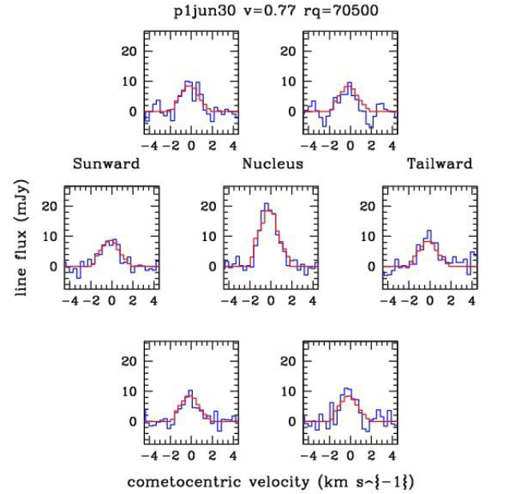
Spectral Mapping
Figure: Spectrum for C/2009 P1 Garradd at 2.757 AU from the Sun on June 30, 2011
Notes:
Data in blue, model in red
Velocity 0.77 km/s, quenching radius 70500 km

Slide 16
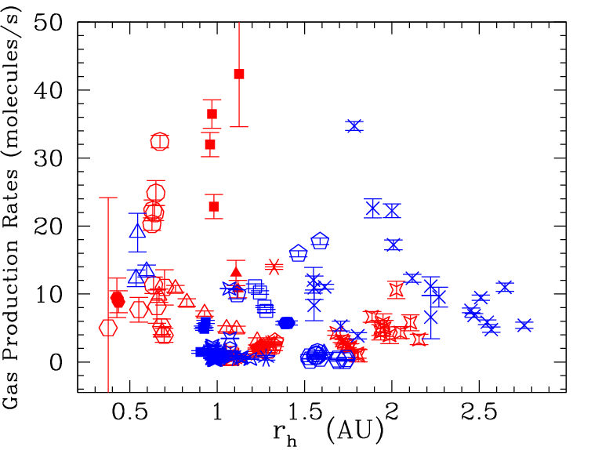
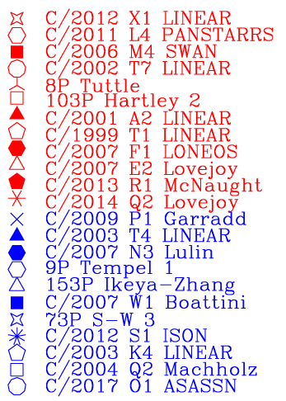
Gas Production vs Heliocentric Distance
Notes:
Figure 4. The heliocentric distance
versus OH production rate of the
comets. There does not appear to be a
clear correlation between the distance
and the OH production rate, though
we do see highest gas productions
nearer to the sun.

Slide 17
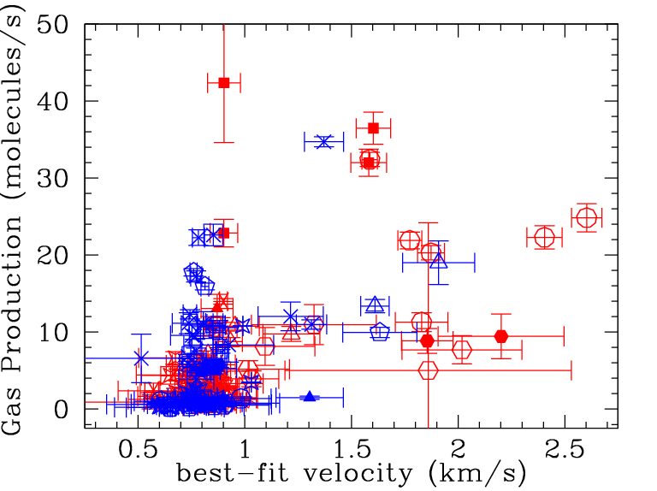
Gas Production vs Gas Velocity
Notes:
Figure 5. OH velocity versus gas production rate, for all observations on the left, and
only low production comets (<1.5x1029 molecules/s) on the right.

Slide 18
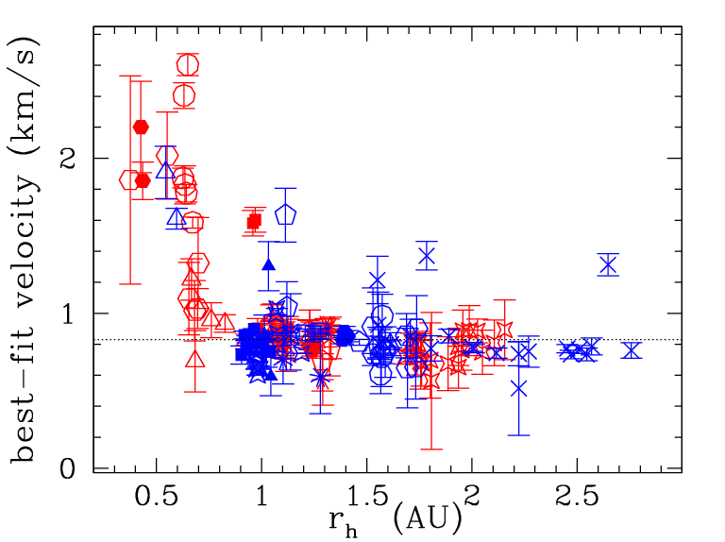
OH Velocity vs Heliocentric Distance
Notes:
Figure 3. There is a clear correlation
between the heliocentric distance and
the OH daughter molecule velocity,
though the velocities level off rather
than continuing to decrease with
increased distance from the sun.
The velocity, averaged over all
comets, is 0.868 ± 0.004, whereas the
average velocity just for comets
outside 1 AU is 0.831 ± 0.004 km/s
(dashed line)

Slide 19
Conclusions and Future Work
Correlations between gas outflow velocity and heliocentric distance
Fewer correlations between gas production and distance or gas production and velocity
Possible reasons for poor fit for some comets: high velocities, spectral inversion factor
Examine different OH initial velocities
Notes:
correlations between gas outflow
velocity and heliocentric distance, but fewer
correlations between gas production with distance
or gas production with velocity.
The resultant molecular velocities range from 0.47 km/s to 3.273 km/s, and the gas production rates cover three orders of magnitude from 0.36 to 123.9 x10^28 molecules/second.
we hope to narrow down places
where the model does not work well. Our current
models also depend on an initial OH velocity of 1.05
m/s. Future work could examine the impact on the
best fit of varying that number

Slide 20
Sources
A. J. Lovell, E. S. Howell, and F. P. Schloerb (unpublished). Observations and Modeling of 18 cm OH Lines in Twenty-Seven Comets. 2016.
A. J. Lovell, E. S. Howell, F. P. Schloerb, B. M. Lewis, and A. A. Hine. Arecibo observations of the 18cm OH lines of six comets. Asteroids, Comets, and Meteors: ACM 2002 500:681-684. 2002.
A. J. Lovell, A. Bonsall, H. Sizemore, and F, Ghigo. Ground-based Observations of Small Solar System Bodies: Probing Our Local Debris Disk. Bulletin of the AAS, 51.3. 2019.
A. L. Cochran, A. Levasseur-Regourd, M. Cordiner, E. Hadamcik, J. Lasue, A. Gicquel, D. G. Schliecher, S. B. Charnley, M. J. Mumma, L. Paganini, D. Bockelee-Morvan, N. Bover, and Y. Kuan. The composition of comets. Space Science Reviews, 197.1:9-46, July 2015.
B. Presler-Marshall, Bachelor’s thesis, Agnes Scott College, 2019.
B. Presler-Marshall, Master’s thesis, University of Central Florida, 2021.
L. E. Tacconi-Garman, F. P. Schloerb, and H. J. Claussen. High spectral resolution observations and kinematic modeling of the 1667 MHz hyperfine transition of OH in Comets Halley (1982i), Giacobini-Zinner (1984e), Hartley-Good (1985l), Thiele (1985m), and Wilson (1986l). The Astrophysical Journal, 364:672-686. 1990.

Slide 21



Acknowledgments

